Slide 1

Context-Free and
Noncontext-Free Languages
Chapter 13

Slide 2
Languages That Are and
Are Not Context-Free
a*b* is regular.
A^{n}B^{n} = {a^{n}b^{n} : n ≥ 0} is context-free but not regular.
A^{n}B^{n}C^{n} = {a^{n}b^{n}c^{n} : n ≥ 0} is not context-free.
Intuitively because a PDA’s stack cannot count all three of the letter regions and compare them

Slide 3
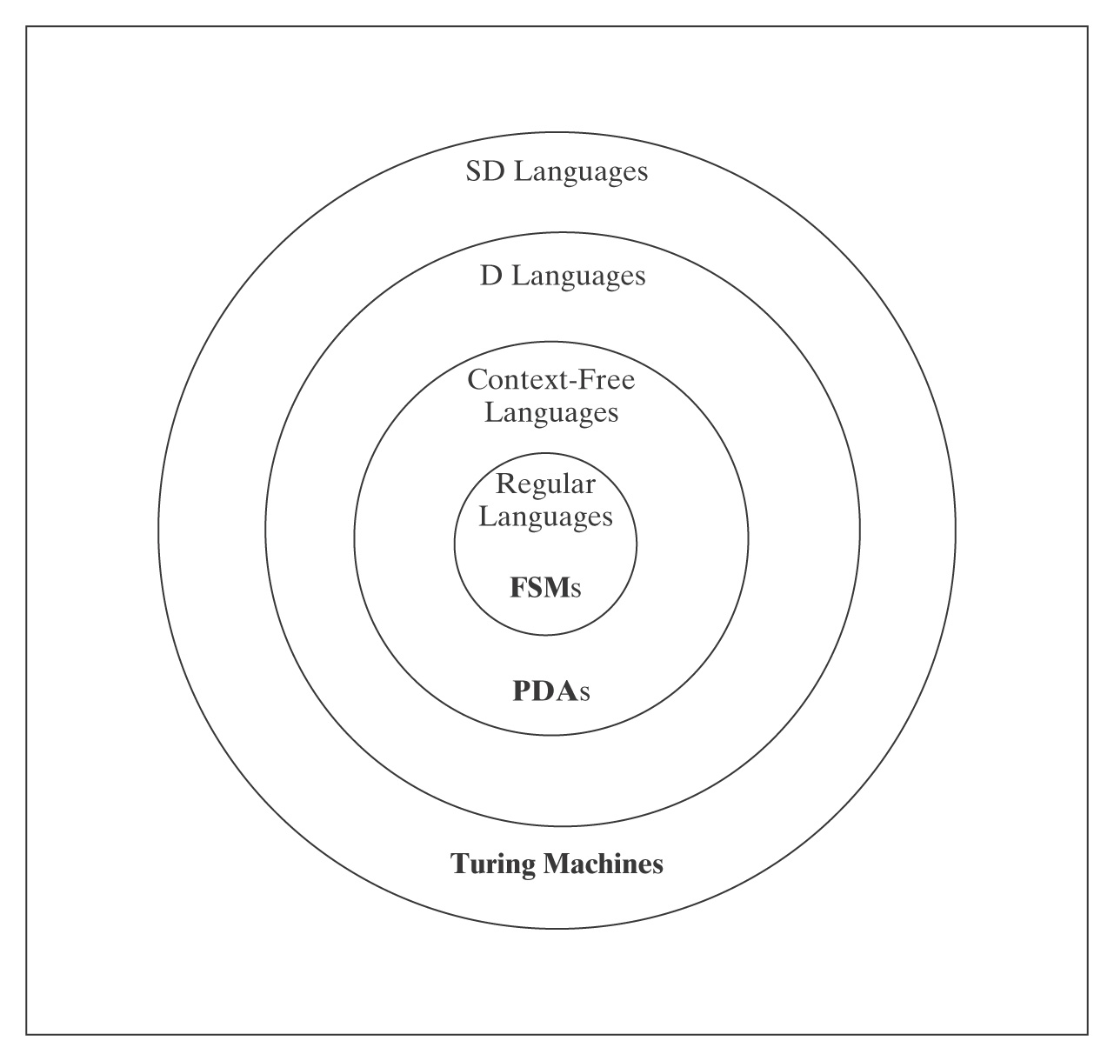
Languages and Machines

Slide 4
The Regular and the CF Languages
  Theorem: The regular languages are a proper subset of the context-free languages.
  Proof: In two parts:
  Every regular language is CF.
  There exists at least one language that is CF but not regular.

Slide 5
The Regular and the CF Languages
  Lemma: Every regular language is CF.
  Proof: Every FSM is (trivially) a PDA:
  Given an FSM M = (K, Σ, Δ, s, A) and elements of δ of the form: ( p, c, q )
  old state, input, new state
  Construct a PDA M' = (K, Σ, {∅}, Δ, s, A). Each (p, c, q) becomes:
  (( p, c, ε ), (q, ε ))
  old state, input, don't new state don't
  look at push on
  stack stack
  In other words, we just don’t use the stack.

Slide 6
There Exists at Least One Language that is CF but Not Regular
  Lemma: There exists at least one language that is CF but not regular
  Proof: {a^{n}b^{n}, n ≥ 0} is context-free but not regular.
  So the regular languages are a proper subset of the context-free languages.

Slide 7
How Many Context-Free Languages Are There?
Theorem: There is a countably infinite number of CFLs.
Proof:
● Upper bound: we can lexicographically enumerate
all the CFGs.
● Lower bound: every regular language is context-free and there is a countably infinite number of regular languages
So, there is at most and at least a countably infinite number of context-free langauges.

Slide 8
How Many Context-Free Languages Are There?
There is an uncountable number of languages (theorem 2.3).
Thus there are more languages than there are context-free languages.
So there must exist some languages that are not context-free.
Example: {a^{n}b^{n}c^{n} : n ≥ 0}

Slide 9
Showing that L is Context-Free
Techniques for showing that a language L is context-free:
1. Exhibit a context-free grammar for L.
2. Exhibit a PDA for L.
3. Use the closure properties of context-free languages.
  Unfortunately, there are fewer closure theorems than regular languages.

Slide 10
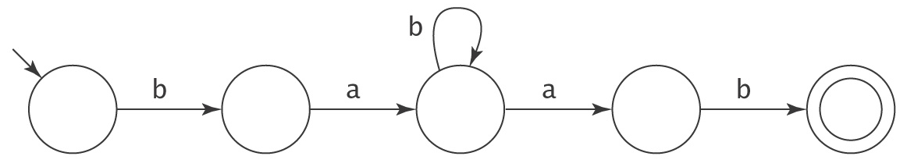
Showing that L is Not Context-Free
Remember the pumping argument for regular languages:
Proof by contradiction: If L were context-free, then it would possess certain properties. But it does not posses those properties. Therefore, L is not context-free.
Context-free pumping theorem is based on the structure of parse trees.

Slide 11
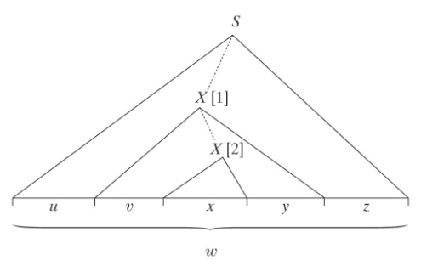
The Context-Free Pumping Theorem
If L is a context-free language, then ∃k ≥ 1, such that
∀ strings w ∈ L, where |w| ≥ k,
∃ u, v, x, y, z, such that: w = uvxyz,and
vy ≠ ε, and
|vxy| ≤ k, and
∀q ≥ 0, uv^{q}xy^{q}z is in L.
Proof: L is generated by some CFG G = (V, Σ, R, S) with n nonterminal symbols and branching factor b. Let k be b^{n + 1}. The longest string that can be generated by G with no repeated nonterminals in the resulting parse tree has length b^{n}. Assuming that b ≥ 2, it must be the case that b^{n + 1} > b^{n}. So let w be any string in L(G) where |w| ≥ k. Let T be any smallest parse tree for w. T must have height at least n + 1. Choose some path in T of length at least n + 1. Let X be the bottom-most repeated nonterminal along that path. Then w can be rewritten as uvxyz. The tree rooted at [1] has height at most n + 1. Thus its yield, vxy, has length less than or equal to b^{n + 1}, which is k. vy ≠ ε since if vy were ε then there would be a smaller parse tree for w and we chose T so that that wasn’t so. uxz must be in L because rule₂ could have been used immediately at [1]. For any q ≥ 1, uv^{q}xy^{q}z must be in L because rule₁ could have been used q times before finally using rule₂.

Slide 12
Regular vs CF Pumping Theorems
Similarities:
● We choose w, the string to be pumped.
● We choose a value for q that shows that w isn’t pumpable.
● We may apply closure theorems before we start.
Differences:
● Two regions, v and y, must be pumped in tandem.
● We don’t know anything about where in the strings v and y will
fall. All we know is that they are reasonably “close together”, i.e.,
|vxy| ≤ k.
● Either v or y could be empty, although not both.

Slide 13
An Example of Pumping: A^{n}B^{n}C^{n}
A^{n}B^{n}C^{n} = {a^{n}b^{n}c^{n}, n ≥0}
Choose w = a^{k} b^{k} c^{k}
1 | 2 | 3
If either v or y spans regions, then let q = 2 (i.e., pump in once). The resulting string will have letters out of order and thus not be in A^{n}B^{n}C^{n}.
If both v and y each contain only one distinct character then set q to 2. Additional copies of at most two different characters are added, leaving the third unchanged. There are no longer equal numbers of the three letters, so the resulting string is not in A^{n}B^{n}C^{n}.

Slide 14
Closure Theorems for Context-Free Languages
The context-free languages are closed under:
● Union
● Concatenation
● Kleene star
● Reverse
● Letter substitution

Slide 15
What About Intersection and Complement?
Closure under complement implies closure under intersection, since:
L₁ ∩ L₂ = ¬(¬L₁ ∪ ¬L₂)
But are the CFLs closed under either complement or intersection?
We proved closure for regular languages two different ways:
1. Given a DFSM for L, construct a DFSM for ¬L by swapping accepting and rejecting states. If closed under complement and union, must be closed under intersection.
2. Given automata for L₁ and L₂, construct an automaton for L₁ ∩ L₂ by simulating the parallel operation of the two original machines,
using states that are the Cartesian product of the sets of states of
the two original machines.
Does either work here?

Slide 16
Closure Under Intersection
The context-free languages are not closed under
intersection:
The proof is by counterexample. Let:
L₁ = {a^{n}b^{n}c^{m}: n, m ≥ 0} /* equal a’s and b’s.
L₂ = {a^{m}b^{n}c^{n}: n, m ≥ 0} /* equal b’s and c’s.
Both L₁ and L₂ are context-free, since there exist
straightforward context-free grammars for them.
But now consider:
L = L₁ ∩ L₂
= {a^{n}b^{n}c^{n}: n ≥ 0}

Slide 17
Closure Under Complement
L₁ ∩ L₂ = ¬(¬L₁ ∪ ¬L₂)
The context-free languages are closed under union, so if they were closed under complement, they would be closed under intersection (which they are not).

Slide 18
Why are the Context-Free Languages Not Closed under Complement, Intersection and Subtraction But the Regular Languages Are?
  Given an NDFSM M₁, build an FSM M₂ such that
  L(M₂) = ¬L(M₁):
  1. From M₁, construct an equivalent deterministic FSM M′,
  using ndfsmtodfsm.
  2. If M′ is described with an implied dead state, add the dead state
  and all required transitions to it.
  3. Begin building M₂ by setting it equal to M′. Then swap the
  accepting and the nonaccepting states. So:
  M₂ = (K_{M′}, Σ, δ_{M′}, s_{M′}, K_{M′} - A_{M′}).
  We could do the same thing for CF languages if we could do step 1,
  but we can’t.
  The need for nondeterminism is the key.

Slide 19
Deterministic PDAs
  A PDA M is deterministic iff:
  ● Δ_{M} contains no pairs of transitions that compete with
  each other, and
  ● Whenever M is in an accepting configuration it has no available moves.
M can choose between accepting and taking the
ε-transition, so it is not deterministic.
ε/ε/ε

Slide 20
Deterministic CFLs
  A language L is deterministic context-free iff L$ can be accepted by some deterministic PDA.
  $: end of string marker Why $?
  Let L = a* ∪ {a^{n}b^{n} : n > 0}.
  When it begins reading a’s, M must push them onto the stack in case there are going to be b’s it runs out of input without seeing b’s, it needs a way to pop out the a’s from the stack before it accepts.
    recall how “accept” was defined
  Add $ to make it easier to build DPDAs, it does not add power (to allow building a PDA for L that was not context-free)

Slide 21
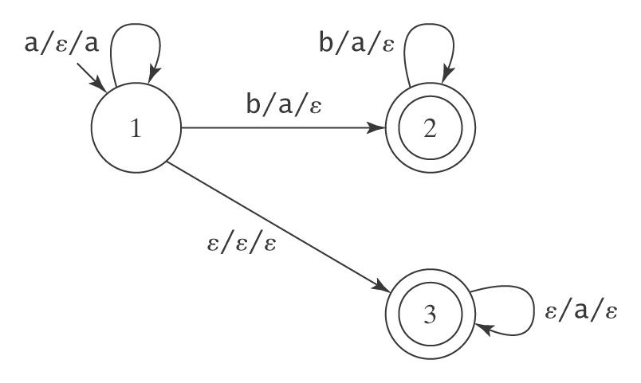
An NDPDA for L
  L = a* ∪ {a^{n}b^{n} : n > 0}.

Slide 22
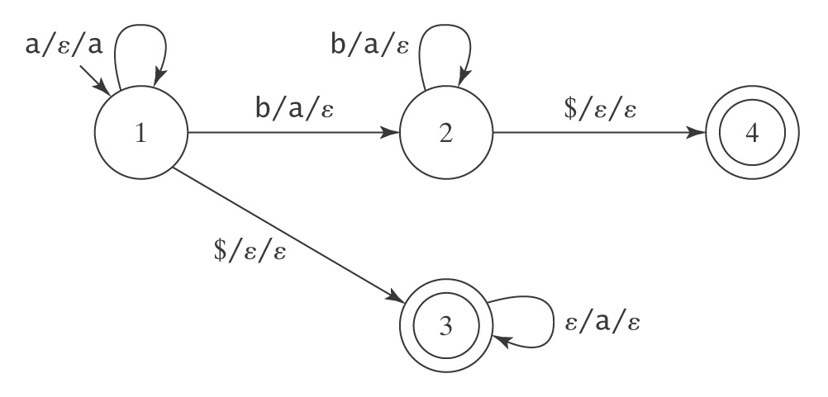
A DPDA for L$
  L = a* ∪ {a^{n}b^{n} : n > 0}.

Slide 23
DCFLs are Closed Under Complement
  Proof by construction.
  L₁ ∩ L₂ = ¬(¬L₁ ∪ ¬L₂).
  What about intersection and union?

Slide 24
DCFLs are Not Closed Under Union
  L₁ = {a^{i}b^{j}c^{k}, i, j, k ≥ 0 and i ≠ j}. (a DCFL)
  L₂ = {a^{i}b^{j}c^{k}, i, j, k ≥ 0 and j ≠ k}. (a DCFL)
  L′ = L₁ ∪ L₂.
  = {a^{i}b^{j}c^{k}, i, j, k ≥ 0 and (i ≠ j) or (j ≠ k)}.
  L′′ = ¬L′.
  = {a^{i}b^{j}c^{k}, i, j, k ≥ 0 and i = j = k} ∪
  {w ∈ {a, b, c}* : the letters are out of order}.
  L′′′ = L′′ ∩ a*b*c*.
  = {a^{n}b^{n}c^{n}, n ≥0}.
  L′′′ is not even CF, much less DCF.

Slide 25
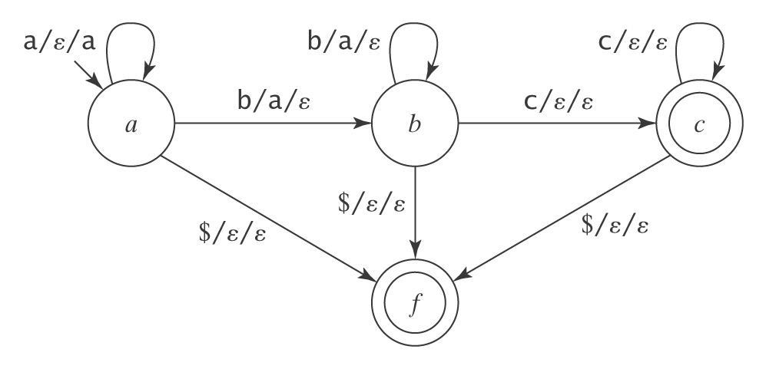
DCFLs are Not Closed Under Intersection
L₁ = {a^{i}b^{j}c^{k}, i, j, k ≥ 0 and i = j}.
L₂ = {a^{i}b^{j}c^{k}, i, j, k ≥ 0 and j = k}.
L′ = L₁ ∩ L₂
=
L₁ and L₂ are deterministic context-free:

Slide 26
Nondeterministic CFLs
Theorem: There exist CLFs that are not deterministic.
Proof: By example. Let L = {a^{i}b^{j}c^{k}, i ≠ j or j ≠ k}. L is CF. If L is DCF then so is:
L′ = ¬L′.
= {a^{i}b^{j}c^{k}, i, j, k ≥ 0 and i = j = k} ∪
{w ∈ {a, b, c}* : the letters are out of order}.
But then so is:
L′′ = L′ ∩ a*b*c*.
= {a^{n}b^{n}c^{n}, n ≥0}.
But it isn’t. So L is context-free but not deterministic context-free.
This simple fact poses a real problem for the designers of efficient context-free parsers.

Slide 27
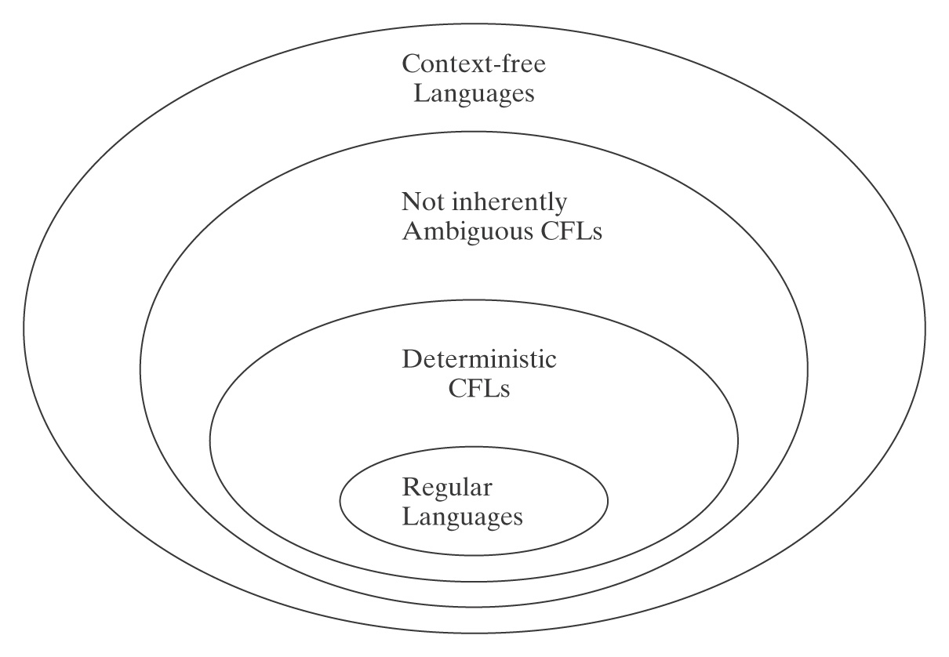
The CFL Hierarchy

Slide 28
Algorithms and Decision Procedures for
Context-Free Languages
Chapter 14

Slide 29
Decidability of CFLs
Theorem: Given a context free language L and a string w, there exists a decision procedure that answers the questions, “is w in L?”
Two approaches:
Find a context-free grammar to generate it
Find a PDA to accept it

Slide 30
Using a Grammar
  decideCFLusingGrammar(L: CFL, w: string) =
  1. If given a PDA, build G so that L(G) = L(M).
  2. If w = ε then if S_{G} is nullable then accept, else reject.
  3. If w ≠ ε then:
    3.1 Construct G′ in Chomsky normal form such that
    L(G′) = L(G) – {ε}.
    3.2 If G derives w, it does so in 2⋅|w| - 1 steps. Try all
    derivations in G of 2⋅|w| - 1 steps. If one of them
    derives w, accept. Otherwise reject.

Slide 31
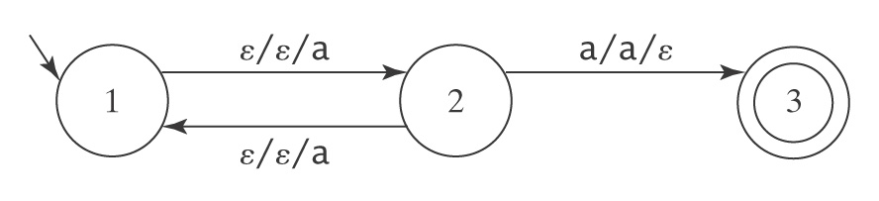
Using a PDA
  Problem:
Theorem: Given any context-free language grammar G = (V, Σ, R, S), there exists a PDA M such that L(M) = L(G) – {ε} and M contains no transitions of the form ((q₁, ε, α), (q₂, β)). In other words, every transition reads exactly one input character.

Slide 32
Greibach Normal Form
  All rules are of the following form:
  ● X → a A, where a ∈ Σ and A ∈ (V - Σ)*.
  No need to push the a and then immediately pop it.
  So M = ({p, q}, Σ, V, Δ, p, {q}), where Δ contains:
  1. The start-up transitions:
  For each rule S → cs₂…s_{n}, the transition:
  ((p, c, ε), (q, s₂…s_{n})).
  2. For each rule X → cs₂…s_{n} (where c ∈ Σ and s₂
  through s_{n} are elements of V - Σ), the transition:
  ((q, c, X), (q, s₂…s_{n}))

Slide 33
A PDA Without ε-Transitions Must Halt
Consider the execution of M on input w:
● Each individual path of M must halt within |w| steps.
● The total number of paths pursued by M must be less than or equal to P = B^{|w|}, where B is the maximum number of competing transitions from any state in M.
● The total number of steps that will be executed by
all paths of M is bounded by P ∗ |w|.
So all paths must eventually halt.
The same for NDFSM

Slide 34
An Algorithm to Decide Whether M Accepts w
decideCFLusingPDA(L: CFL, w: string) =
1. If L is specified as a PDA, use PDAtoCFG to construct a
grammar G such that L(G) = L(M).
2. If L is specified as a grammar G, simply use G.
3. If w = ε then if S_{G} is nullable then accept, otherwise reject.
4. If w ≠ ε then:
  4.1 From G, construct G′ such that L(G′) = L(G) – {ε} and
  G′ is in Greibach normal form.
  4.2 From G′ construct a PDA M such that L(M) = L(G′)
  and M′ has no ε-transitions.
  4.3 All paths of M are guaranteed to halt within a finite
  number of steps. So run M on w. Accept if it accepts
  and reject otherwise.
What can you say about PDA’s halting behavior?
A PDA M must halt ?
For an arbitrary PDA M, there exists M’ that halts and L(M’) = L(M) ?
Notes:
False
true

Slide 35
Decidability of Emptiness and Finiteness
Theorem: Given a context free language L, there exists a decision procedure that answers the following questions:
1. Given a context-free language L, is L = ∅?
2. Given a context-free language L, is L infinite?

Slide 36
Equivalence of DCFLs
Theorem: Given two deterministic context-free languages L₁ and L₂, there exists a decision procedure to determine whether L₁ = L₂.

Slide 37
The Undecidable Questions about CFLs
● Is L = Σ*?
● Is the complement of L context-free?
● Is L regular?
● Is L₁ = L₂?
● Is L₁ ⊆ L₂?
● Is L₁ ∩ L₂ = ∅?
● Is L inherently ambiguous?
● Is G ambiguous?

Slide 38
CFL Summary
  The theory of CFL is not as tidy as the theory of RL
  Interesting subsets, DCFL, and not inherently ambiguous CFL, are only proper subset of CFL
  Not closed under many common operations
  No algorithm for minimizing PDAs
  No fast recognition algorithm that works on arbitrary CFL
  No decision procedure for many important questions
  Yet substantial effort has been invested in CFLs as they are useful

Slide 39
RLs vs. CFLs
  Regular Languages Context-Free Languages
  ● regular exprs. ● context-free grammars
  ● or
  ● regular grammars
  ● = DFSMs ● = NDPDAs
  ● recognize ● parse
  ● minimize FSMs ● find unambiguous grammars
  ● reduce nondeterminism in PDAs
  ● find efficient parsers
  ● closed under: ● closed under:
  ♦ concatenation ♦ concatenation
  ♦ union ♦ union
  ♦ Kleene star ♦ Kleene star
  ♦ complement
  ♦ intersection ♦ intersection w/ reg. langs
  ● pumping theorem ● pumping theorem
  ● D = ND ● D ≠ ND

